Slide 1
Chapter 3 Variables
A variable is a name for a value stored in memory.
Variables are used in programs so they should have meaningful names.
Variables are created using a declaration statement. For example:
Dim length As Integer
Declaration statements include the keyword Dim, the variable name, and the type.
Notes:
Variable name is called identifier. Identifier names must begin with a letter and contain only: letters, numbers and some special characters. If 2 words are concatenated the second should begin with a capital letter ( Ex: rectangleWidth ) so it is easy to read.
Data type determines the only type of data the variable will store.
Assignment requires an equal sign (=). The value on the right is "given to" or "assigned" the value of the variable on the left.
Multiple variables can be declared in a single statement:
Dim length, width As Integer
GPS: group variables in one statement when they represent related items only.
GPS: variable declarations should be grouped at the beginning of a procedure

Slide 2
Chapter 3 Variable Assignment
A variable can store only one value at any time.
Dim x As Integer;
x = 5;
x = 10;
X
10
5
Notes:
Note: This slide contains animations. Press the space bar or click the mouse button to display each animation.
This slide contains three (3) animations.
The variable declaration, x, associates the variable name x with a memory location <press space bar>
The first assignment statement, x = 5, associates the memory location for x with the value 5 <press space bar>
The second assignment statement, x = 10, associates the memory location for x with the value 10 <press space bar>
Note that once the variable x is associated with a new value, in this case 10, the previous value, 5, cannot longer be accessed.

Slide 3
Chapter 3 Retrieving User Input
Input can be in the form of data typed by the user at run time.
A TextBox object allows users to enter values.
A text box usually displays a prompt to inform the user what type of data is expected.

Slide 4
Chapter 3 The TextBox Control
(Name) should begin with txt.
MaxLength can be set to a numeric value indicating the maximum number of characters
ChracterCasing will convert characters ( Upper…)
Text is what is displayed in the text box. At run time, this property can be used in an assignment statement to retrieve the data typed by the user.
TextAlign sets the alignment of text relative to the text box.
Notes:
A TextChanged event procedure is sometimes coded for a TextBox object. This procedure executes when the user types in the text box.
If the text box does not contain data that matches the variable type a run-time error occurs and the program is halted

Slide 5
Chapter 3 The Val() Function
A function performs a single, well-defined task and returns a value.
Val() is used to convert text box data to a numeric value.
Val() requires a string and then returns a number corresponding to the string. For example:
Dim height As Integer height = Val("62 cm.") 'height = 62 height = Val("33") 'height = 33 height = Val(Me.txtHeight.Text)
Notes:
Val() is used to prevent run-time error when the data in the input box does not match the variable type.
Modify coins for example and run it with integer ( OK ) or char ( run-time error )
If the first char of the string is not a numeric character Val() returns a 0.

Slide 6
Chapter 3 Built-In Data Types
Type Used For
Integer whole numbers
Double numbers with a decimal portion
Decimal currency values
Date dates
Char individual characters
String a set of characters
Boolean true/false, on/off, yes/no values
Notes:
It is important to choose the most appropriate data type for the quantity being represented. This has two benefits. First, both the compiler and the reader will understand the possible values for a variable. Second, the compiler allocates the appropriate amount of memory for the variable.
Type Used For
Integer whole numbers from -2,147,483,648 to 2,147,483,647 4 bytes
Double numbers with a decimal portion called also floating point 8 bytes
Decimal currency values 16 bytes
Date dates 8 bytes
Char individual characters 2 bytes ( Unicode )
String a set of characters 2 bytes
Boolean true/false, on/off, yes/no v 2 bytes

Slide 7
Chapter 3 Type Conversion
In an assignment statement, Visual Basic automatically converts data to match the type of the variable it is being assigned to. For example:
Dim x As Integer x = 6.7 'x assigned 7
Notes:
Assigning 12.3 to an Integer is valid because data is converted to 12.
Assigning abc to an Integer generates an Error.

Slide 8
Chapter 3 Variable Scope
Notes:
The placement of a variable declaration is important because it determines the variable's scope.
The scope of a variable is the set of statements that can access the variable.
A global variable is accessible to any code in the form class. It has to be declared in the Form class above any procedure declarations.
A local variable is accessible to the procedure it is declared in only.
Scope Demo

Slide 9
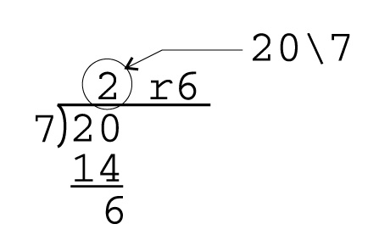
Chapter 3 Integer Division
Integer division (\) truncates the decimal portion of the quotient. Only the integer portion of the quotient is returned:
Notes:
Dim x As Integer
X = 20 \ 7 ‘x is assigned 2

Slide 10
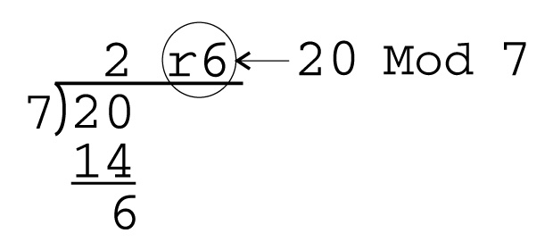
Chapter 3 Modulus Division
Modulus division returns the remainder of a division operation:
Operator precedence ( PEMDIMAS ): (), ^, *, /, \, Mod, +, -
Notes:
Dim x As Integer
X = 20 Mod 7 ‘x is assigned 6

Slide 11
Chapter 3 Named Constants
A constant is a name for a memory location that stores a value that cannot be changed from its initial assignment.
Constants are created using a declaration statement. For example:
Const PI As Double = 3.14
Constant identifiers are typically all uppercase with an underscore (_) separating words within the identifier name.
The value of a constant is assigned only in the declaration -> otherwise” Syntax error!”
Notes:
Because constants do not change values it is safe to allow a broader scope. Therefore constant declarations are often placed in the Form class, outside any procedure.
GPS: group constants and declare before variables

Slide 12
Chapter 3 Visual Basic Keywords
And | Dim | False | Long | Return
Boolean | Do | Finally | Me | Select
Byte | Double | For | Mod | Short
Call | Each | Friend | Module | Single
Case | Else | Function | New | Static
Catch | ElseIf | Get | Not | Stop
Const | End | Handles | Nothing | String
Date | Enum | If | Object | Structure
Decimal | Erase | In | Or | Sub
Declare | Error | Integer | Private | Then
Default | Event | Is | Protected | To
Delegate | Exit | Like | Public | True
Notes:
Keywords have special meaning to the Visual Basic compiler and therefore cannot be used for a variable or constant identifier.

Slide 13
Chapter 3 Programming Errors
Errare humanum est
Syntax errors violate the rules of Visual Basic.
Logic errors, also called semantic errors, occur in statements that are syntactically correct, but produce undesired or unexpected results.
Run-time errors, also called exceptions, halt program execution at the statement that cannot be executed.
Notes:
Logic errors are more difficult to detect.
Example:
Dim length As Integer
Dim area As Double
length = 1.2 ‘ 1 is actually assigned
area = length ^ 2 ‘ expected value is 1.44 but result is 1
Runtime errors are errors not detected by the compiler.

Slide 14
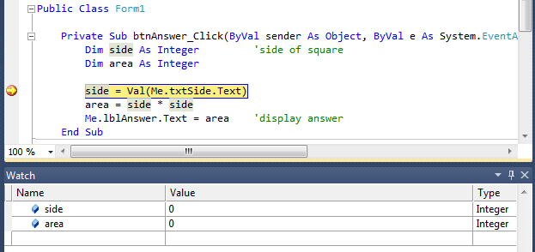
Chapter 3 The Visual Basic Debugger
Make clear that Troubleshooting/Debugging is part of Programming ( 10% inspiration 90% perspiration.
Notes:
The source of logic errors can be hard to determine without tools for debugging. A breakpoint is created by clicking in the gray area to the left of a statement.
The screen shows break mode where program execution has stopped at a breakpoint. The Watch (at the bottom of the screen) shows the current value of selected variables. Selecting Debug -> Step Into steps through the program statement by statement.
When the app is run, program execution stops at the first breakpoint and the IDE goes into break mode. In break mode the Watch window can be used to examine values. Right click a variable, constant or object name displays a menu with an Add Watch command. Program execution is continued from a break point by clicking Step Into button or pressing F8. App is executed one statement at a time.
Another technique is to select certain lines of code and then click “comment out the selected lines” button. The lines will not be executed.
Hovering over a variable with the mouse displays the variable’s current value.

Slide 15
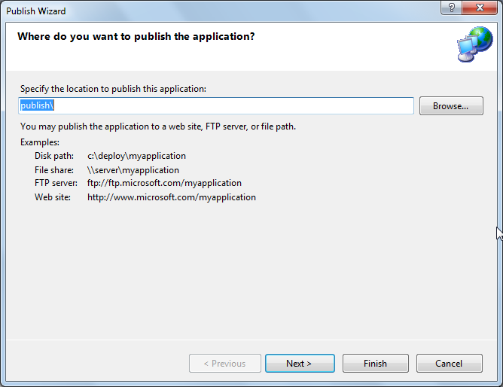
Chapter 3 Application Deployment
Notes:
The Publish Wizard is used to package an application so that it can be run on another computer system.

Slide 16
Chapter 3 Code Conventions
Variable identifiers should begin with a lowercase letter and any word after the first within the identifier should begin with an uppercase letter. (camel case)
Group variables together in the same declarations only when variables represent related items.
Use a blank line after a group of declarations to make it clear where declarations end.
Use a descriptive prompt next to a text box to tell the user what kind of input is expected.

Slide 17
Chapter 3 Code Conventions (cont.)
Choose data types that appropriate for the type of data being represented.
Declare variables so that their scope is limited to where they are needed.
Constant identifiers should be all uppercase with underscore characters separating words.
Group constant declarations before variable declarations.

